Slide 1
CS224 I/O

Slide 2
Timers
Timer1 is 16-bit timer
2^16-1 or 65,535
SYSCLK = 40MHz,
Prescalers
1:1, 1:8, 1:64, and 1:256
Use T1CONbits.TCKPS=3 for 1:256 scaling
Prescalar: 1:256, with 40MHz, the timer will be reset every 1/40e6 * 256 * 65535 = 0.419s.

Slide 3
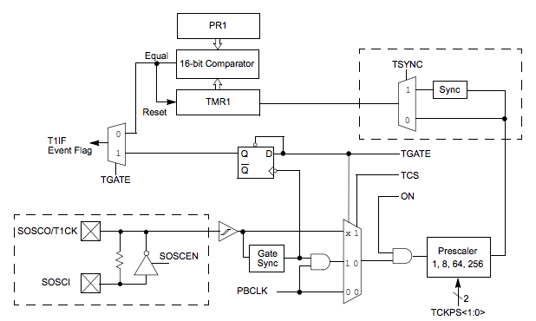
Timer Implementation

Slide 4
Analog Input and Output
Interface with the real world
Analog-­‐to-­‐digital-­‐converter(ADC)
Digital-­‐to-­‐analog-­‐converter(DAC)

Slide 5
Analog-to-Digital Conversion
Terminology
analog: continuously valued signal, such as temperature or speed, with infinite possible values in between
digital: discretely valued signal, such as integers, encoded in binary
analog-to-digital converter: ADC, A/D, A2D; converts an analog signal to a digital signal
digital-to-analog converter: DAC, D/A, D2A
An embedded system’s surroundings typically involve many analog signals.

Slide 6
Analog Signals
Analog signals – directly measurable quantities in terms of some other quantity
Examples:
Thermometer – mercury height rises as temperature rises
Car Speedometer – Needle moves farther right as you accelerate
Stereo – Volume increases as you turn the knob.

Slide 7
Just what does an A/D converter DO?
Converts analog signals into binary words

Slide 8
Digital Signals
Digital Signals – have only two states. For digital computers, we refer to binary states, 0 and 1. “1” can be on, “0” can be off.
Examples:
Light switch can be either on or off
Door to a room is either open or closed

Slide 9
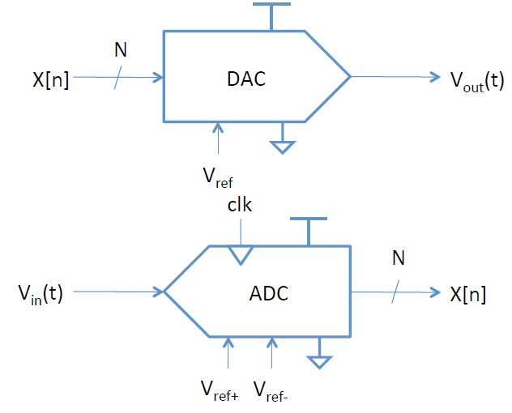
DAC/ADC Characterisc
Resolution
Dynamic range
Sampling rate
Accuracy

Slide 10
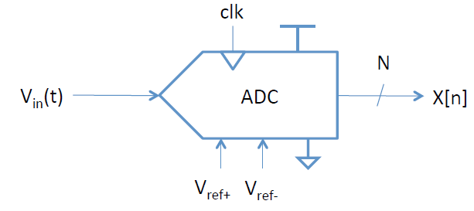
Example ADC
Resolution: N = 12-­‐bit
Range: Vref- to Vref+ = 0-5 V
Sampling fs = 44 KHz
Accuracy: ± 3 least significant bits (lsbs)

Slide 11
Analog-to-digital converters
V_{max} = 7.5V
1111
4
4
7.0V
1110
6.5V
1101
3
3
6.0V
1100
5.5V
1011
2
2
5.0V
1010
analog input (V)
analog output (V)
4.5V
1001
1
1
4.0V
1000
3.5V
0111
3.0V
0110
t1
t2
t3
time
t1
t2
t3
t4
time
2.5V
0101
t4
2.0V
0100
0100
0110
0110
0101
0100
1000
0110
0101
1.5V
0011
Digital output
Digital input
1.0V
0010
0.5V
0001
0V
0000
proportionality
analog to digital
digital to analog
Embedded Systems Design: A Unified Hardware/Software Introduction, (c) 2000 Vahid/Givargis

Slide 12
Proportional Signals
Simple Equation
Assume minimum voltage of 0 V.
Vmax = maximum voltage of the analog signal
a = analog value
n = number of bits for digital encoding
2^{n} = number of digital codes
M = number of steps, either 2^{n} or 2^{n} – 1
d = digital encoding
a / Vmax = d / M
 | Vmax
 | 0 V
 | 1..1 = 2^{n}-1
…
 | 0..0 = 0

Slide 13
Resolution
Let n = 2
M = 2^{n} – 1
3 steps on the digital scale
d₀ = 0 = 0b00
d_{Vmax} = 3 = 0b11
M = 2^{n}
4 steps on the digital scale
d₀ = 0 = 0b00
d_{Vmax - r} = 3 = 0b11 (no d_{Vmax} )
r, resolution: smallest analog change resulting from changing one bit
 | Vmax
 | 0 V
 | 3=11
 | 2=10
 | 1=01 0=00
r
 | 3=11
 | 2=10
 | 1=01 0=00

Slide 14
Sampling Rate
Frequency at which ADC evaluates analog signal. As we see in the second picture, evaluating the signal more often more accurately depicts the ADC signal.

Slide 15
Method to reduce aliasing noise
Use low pass filter to remove high frequency
before sampling
Input voltage = V
Low
Pass
Filter:
f_{corner}=20KHz
ADC
Sampling
at 40KHz
output code = n
0110001
0100010
0100100
0101011
:
:
:
e.g.
Max freq
=20KHz
Gain(dB)
0
-3dB cut off
Freq.

Slide 16
PIC32 ADC Basics
Conversion: is when the voltage in the sample and hold capacitor is converted into a binary representation usable in software
For PIC32’s, the conversion is done by means of a successive approximation register (SAR)
A successive approximation ADC compares the pins voltage to an internal analog voltage generated by an internal DAC (digital-to-analog converter of course).
The DAC voltage will be incremented until a match is found. When this happens, the 10-bit value used to drive the DAC becomes the 10-bit analog value.

Slide 17
PIC 32
10-bit ADC built-in
1 million samples/sec (Msps)
Any of 16 analog input pins
AN0-15
Shared with digital I/O port RB
Vref+ = VDD (3.3V)
Vref- = GND(0 V)

Slide 18
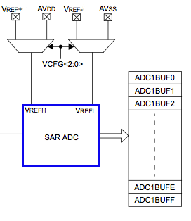
Control Registers
AD1CON1-3
primary control
AD1CHS
channel select
AD1PCFG
pin configuration
AD1CSSL
see data sheet
ADC1BUF0-F
10-bit conversion result

Slide 19
Analog Input Example
#include <P32xxxx.h>
void initadc(int channel) {
AD1CHSbits.CHOSA = channel; // select which channel
AD1PCFGCLR = 1 << channel; // configure input pin
AD1CON1bits.ON = 1; // turn ADC on
AD1CON1bits.SAMP = 1; // begin sampling
AD1CON1bits.DONE = 0; // clear DONE flag
}
int readadc(void) {
AD1CON1bits.SAMP = 0; // end sampling, star conversion
while (AD1CON1bits.DONE); // wait until DONE
AD1CON1bits.SAMP = 1; // resume sampling
AD1CON1bits.DONE = 0; // clear DONE flag
return ADC1BUF0; // return result
}
int main(void) {
int sample;
initadc(11);
sample = readadc();
}

Slide 20
int analogRead(char analogPIN)
{
AD1CHS = analogPIN << 16;
// AD1CHS<16:19> controls which analog pin goes to the ADC
AD1CON1bits.SAMP = 1; // Begin sampling
while( AD1CON1bits.SAMP );
// wait until acquisition is done
while( AD1CON1bits.DONE );
// wait until conversion done
return ADC1BUF0; // result stored in ADC1BUF0
}

Slide 21
DAC Conversion
No built-in DACs
Some accept N-parallel wires
Some accept serial (such as SPI)
Flexible voltage vs. not
May need an op-amp

Slide 22
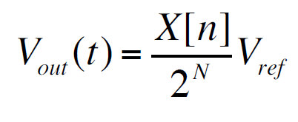
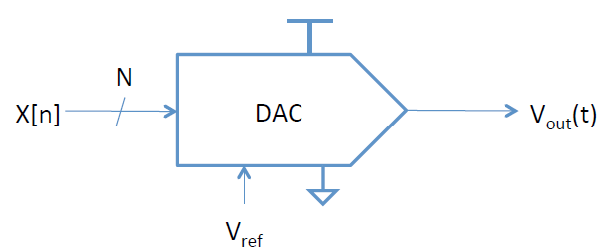
DAC vs. ADC
Vmax
DAC:
n digital inputs for digital encoding d
analog input for Vmax
analog output a
x0
DAC
x1
…
a
Xn-1

Slide 23
Examples
AD558 8-bit parallel DAC
analog.com
LTC1257 12‐bit serial DAC
linear.com
Texas Instruments also makes

Slide 24
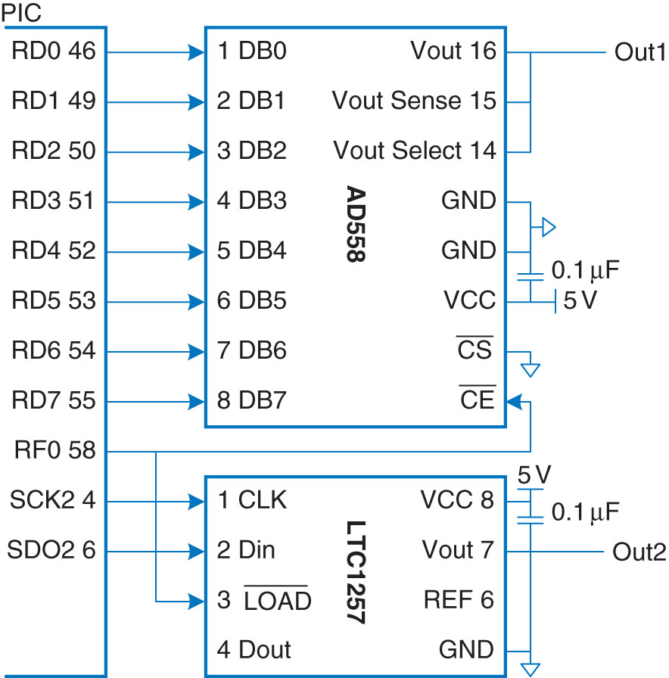
DAC Circuit

Slide 25
DAC sine and triangle waves
#include <P32xxxx.h>
#include <math.h>
#define NUMPTS 64
int sine[NUMPTS], triangle[NUMPTS];
void initio(int freq) { // 5-605 Hz frequency
TRISD = 0xFF00; // PORT D outputs
SPI2CONbits.ON = 0; // disable to reset state
SPI2BRG = 9; // 1 MHz SPI clock
SPI2CONbits.MSTEN = 1; // enable master mode
SPI2CONbits.CKE = 1; // set clock-to-data timing
SPI2CONbits.MODE16 = 1; // activate 16-bit mode
SPI2CONbits.ON = 1; // turn SPI on
TRISF = 0xFFFE; // make RF0 an output (load and ce)
PORTFbits.RF0 = 1; // set RF0 = 1
PR1 = (20e6/NUMPTS)/freq – 1; // set period register for frequency
T1CONbits.ON = 1; // turn Timer1 on
}

Slide 26
DAC Cont’d
void initwavetables(void) {
int i;
for (i=0; i<NUMPTS; i++) {
sine[i] = 2047*(sin(2*3.14159*i/NUMPTS) + 1); // 12-bit
if (i<NUMPTS/2) triangle[i] = i*511/NUMPTS; // 8-bit
else triangle[i] = 510 – i*511/NUMPTS;
}
}
void genwaves(void) {
int I;
while(1) {
for (i=0; i<NUMPTS; i++) {
IFSObits.T1IF = 0; // clear timer overflow flag
PORTFbits.RF0 = 1; // disable load while changing
SPI2BUF = sine[i]; // send points to DACs
PORTD = triangles[i];
while(SPI2STATbits.SPIBUSY); // wait until complete
PORTFbits.RF0 = 0; // load new points into DACs
while (IFSObits.T1IF); // wait until time for next
}
}
}

Slide 27
DAC main
int main(void) {
initio(500);
initwavetables();
genwaves();
}

Slide 28
Pulse-width Modulation
Analog through digital duty cycle
Example:
Output from 0 to 3.3V
25% duty cycle
Use output compare (OC1‐OC5)
Use Timer 2 or 3 also

Slide 29
PWM
Is a technique for getting analog results with digital means.
Digital control is used to create a square wave, a signal switched between on and off.
This on-off pattern can simulate voltages in between full on (5 Volts) and off (0 Volts) by changing the portion of the time the signal spends on versus the time that the signal spends off.
The duration of "on time" is called the pulse width.
To get varying analog values, you change, or modulate, that pulse width.
If you repeat this on-off pattern fast enough with an LED for example, the result is as if the signal is a steady voltage between 0 and 5v controlling the brightness of the LED.

Slide 30
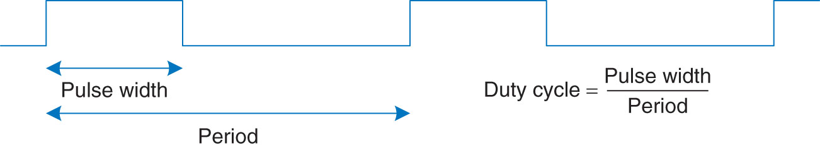
PWM

Slide 31
Output Compare (PIC32)
OCxCON – control register
OCM bits set to 110 for PWM
ON bit enabled
OCTSEL (Timer2 in 16--‐bit by default)
OCxR – see data sheet
OCxRS – sets duty cycle
Timer’s period register (PR) sets period

Slide 32
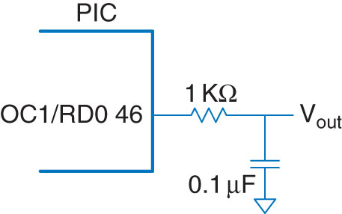
Example
78.125 KHz signal on OC1

Slide 33
Example Code
#include <P32xxx.h>
void genpwm(int dutycycle) {
PR2 = 255;
// set period to 255+1 ticks (78.125 KHz)
OC1RS = dutycycle;
OC1CONbits.OCM = 0b110;
// set OC1 to PWM mode
T2CONbits.ON = 1;
// default mode (20 MHz, 16-bit)
OC1CONbits.ON = 1;
// turn on OC1
}

Slide 34
Motors
DC motors
High current
Powerful driver (H-bridge)
Servo motors
Not as powerful
Specific position (not continuous rotation)
Stepper motors
Rotates by a fixed angle (step)
Expensive and need a powerful driver

Slide 35
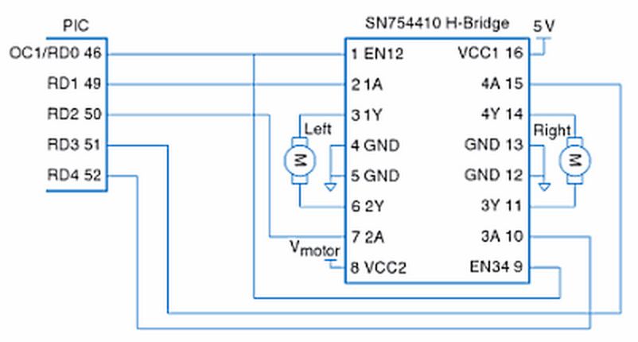
PWM Example from Book

Slide 36
Example Code
void setspeed(int dutycycle) {
OC1RS = dutycycle; // set duty cycle between 0 and 100
}
void setmotorleft(int dir) { // dir of 1 = forward, 0 = back
PORTDbits.RD1 = dir; PORTDbits.RD2 = dir;
}
void initmotors(void) {
TRISD = 0xFFE0;
halt();
T2CONbits.TCKPS = 0b111; // prescale by 256 to 78.125 KHz
PR2 = 99; // set period to 99+1 ticks ~781Hz
OC1RS = 0; // start with low H-bridge enable
OC1CONbits.OCM = 0b110; // set output compare to PWM
T2CONbits.ON = 1;
OC1CONbits.ON = 1; // turn on PWM
}
void halt(void) {
PORTDCLR = 0x001E; // turn both motors off
}

Slide 37
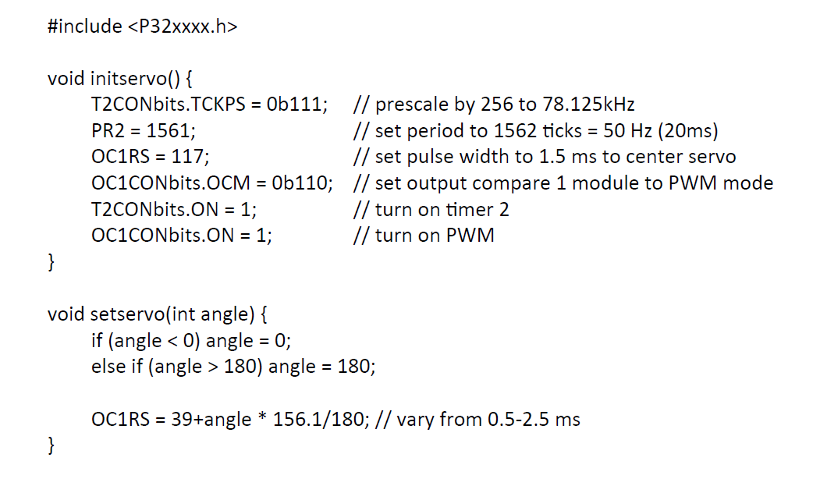
Servo PIC

Slide 38
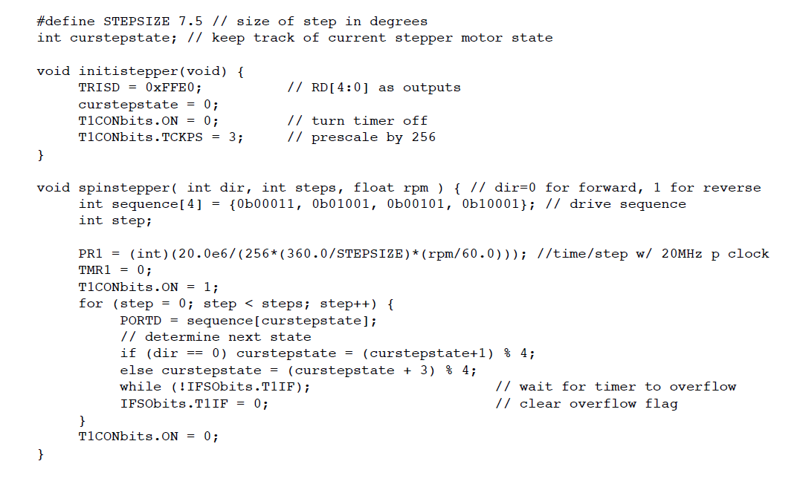
Stepper Motor

